Slide 1
Understanding By Design (UBD)
(Wiggins & McTighe, 1998)
Understanding By Design (UBD)—in Organizational Leadership, followers are more willing and able to support, meet, and exceed the goals if they are valued as key players in the success and know what the ultimate goals are.

Slide 2
UBD + Action Plan
1. Consider your Team Vision.
Walk “Backwards” Down the
Steps from that Goal.
Work Together to Come to the Starting Point
to Reach that Goal.
(Wiggins & McTighe, 1998)

Slide 3
Action Plan
A Document that Lists a Sequence of Steps that Must Be Performed Well, For A Strategy To Succeed; that is to attain your Goal.
Three Major Elements
Specific Tasks: What Will be done and by Whom.
Deadline: When Will It Be Done.
Resource Allocation: What Specific Funds Are Available for Specific Activities

Slide 4
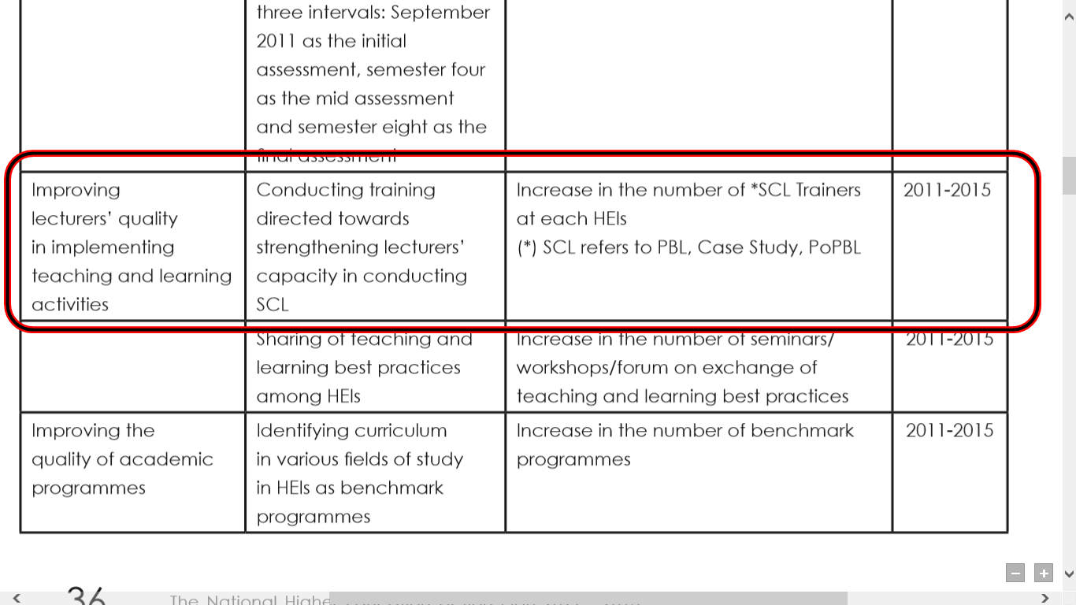
EXAMPLE

Slide 5
Your Team Action Plan
Specific Goal | Specific Tasks 5 Ws & an H* | Resource Allocation | Deadline

Slide 6
Specific Tasks 5 Ws & an H*
Who is Responsible?
What Specifically is to be Done?
Where will this be Done?
When do we need it by?
How will this be done?
Who Checks that it is Done?
(McCarthy, often)

