Slide 1


UNIVERSITY SUPPORT
and Work Force
Development Program
Leadership Development Workshop
Day 4
Dr. Ray McCarthy

Slide 2
Leadership Venn Diagram
Followership
Leadership
Communication

Slide 3
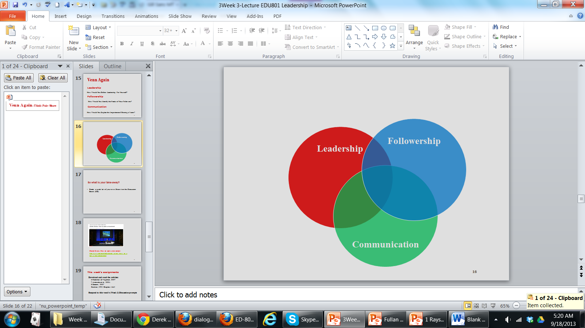
Leadership Venn Diagram
Leadership
How Would You Define Leadership For Yourself?
Followership
How Would You Identify the Needs of Your Followers?
Communication
How would you explain the importance of sharing a Vision?

Slide 4
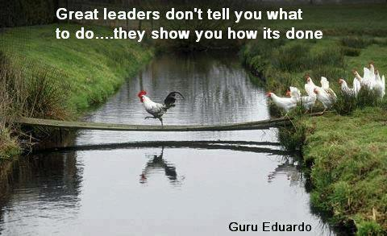
Welcome!
http://drraymccarthy.weebly.com/
Day 4
Dr. Ray McCarthy drraymccarthy@gmail.com

Slide 5
"In times of change
learners inherit the earth; while the learned find themselves beautifully equipped to deal with a world that no longer exists."
(Eric Hoffer, n.d.)

Slide 6
Team Assignment: Student Affairs
What did you discover?
What would you do to
get evidence?
What are the
implications of this
information?
Student Affairs
Graduate
Employability
Faculty
Influence

Slide 7
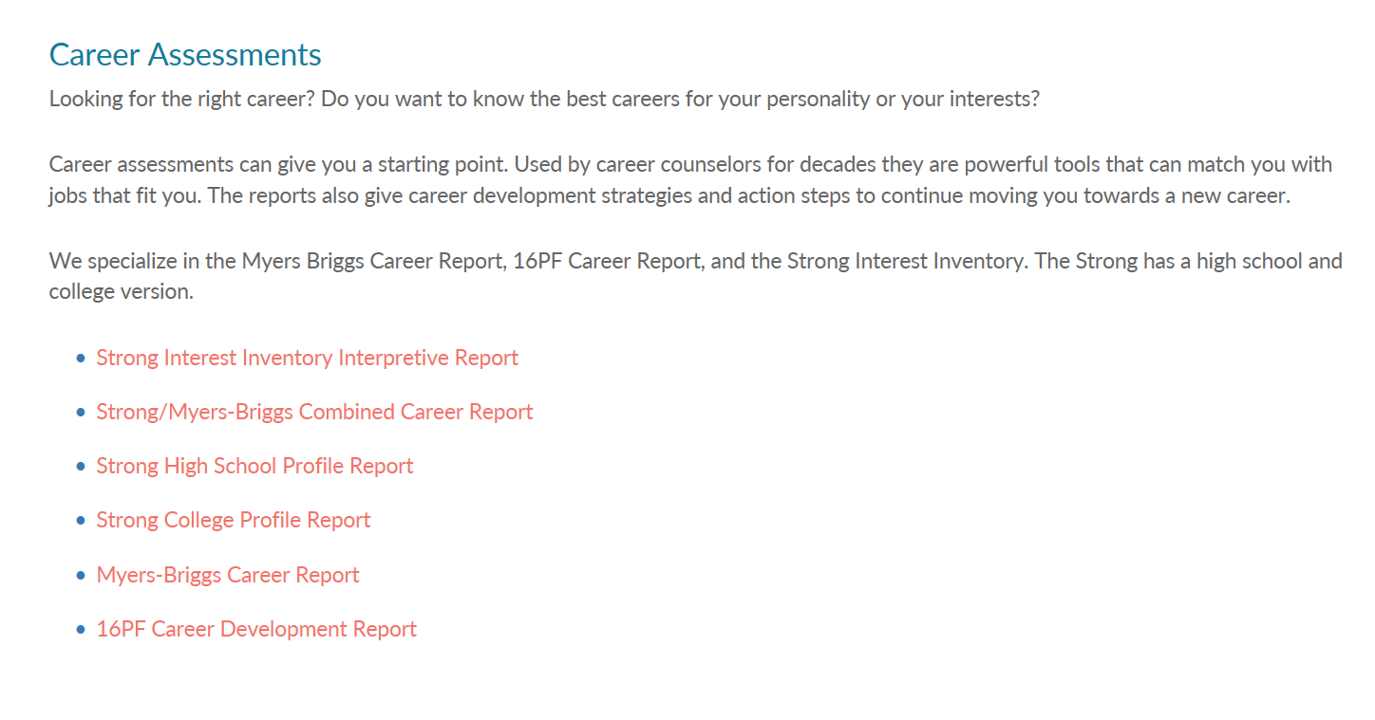
Student Affairs
Myers–Briggs Type Indicator
http://www.discoveryourpersonality.com/career-tests.html
Katharine Cook Briggs & Isabel Briggs Myers

Slide 8
W | S | S.W.O.T. Matrix
OW | OS | O
TW | TS | T
Example: Opportunity + Strength =

Slide 9
Today’s Agenda
Welcome
Leader’s Tool Box
Understanding By Design
Vision Statements
Action Plans
Reflection
Next Steps

Slide 10

Great Leading is Great Teaching
“…at Toyota…every team leader and manager is a teacher first!”
(Liker & Meier, 2007)

Slide 11
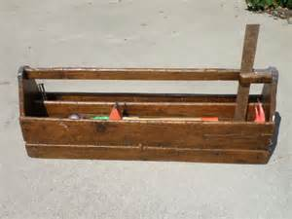

Leader’s Tool Box
(Dr. Joe Berger, Often)
“If the only tool you have is a hammer, you tend to treat every
problem as if it were a nail.”
(Maslow, 1966)

Slide 12
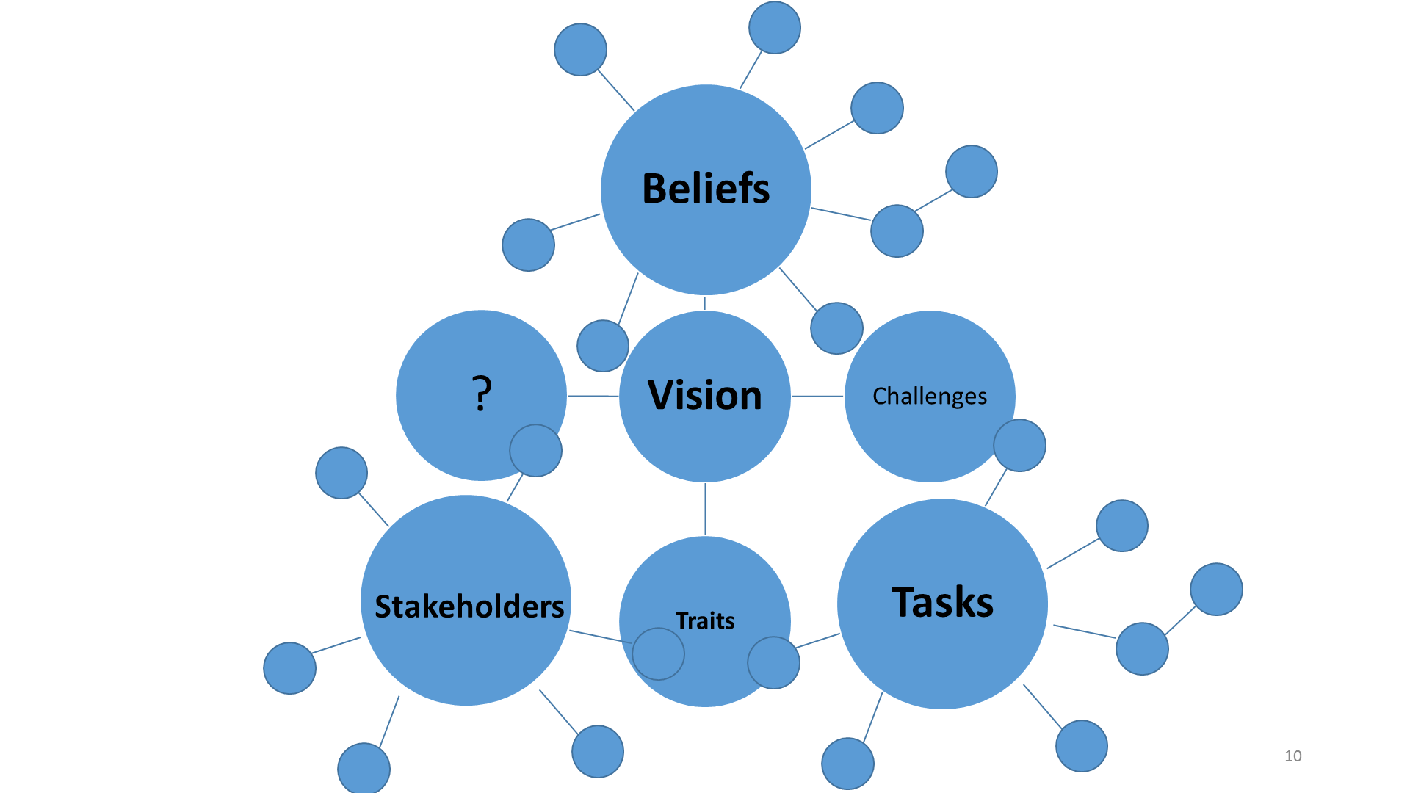
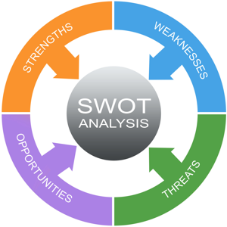
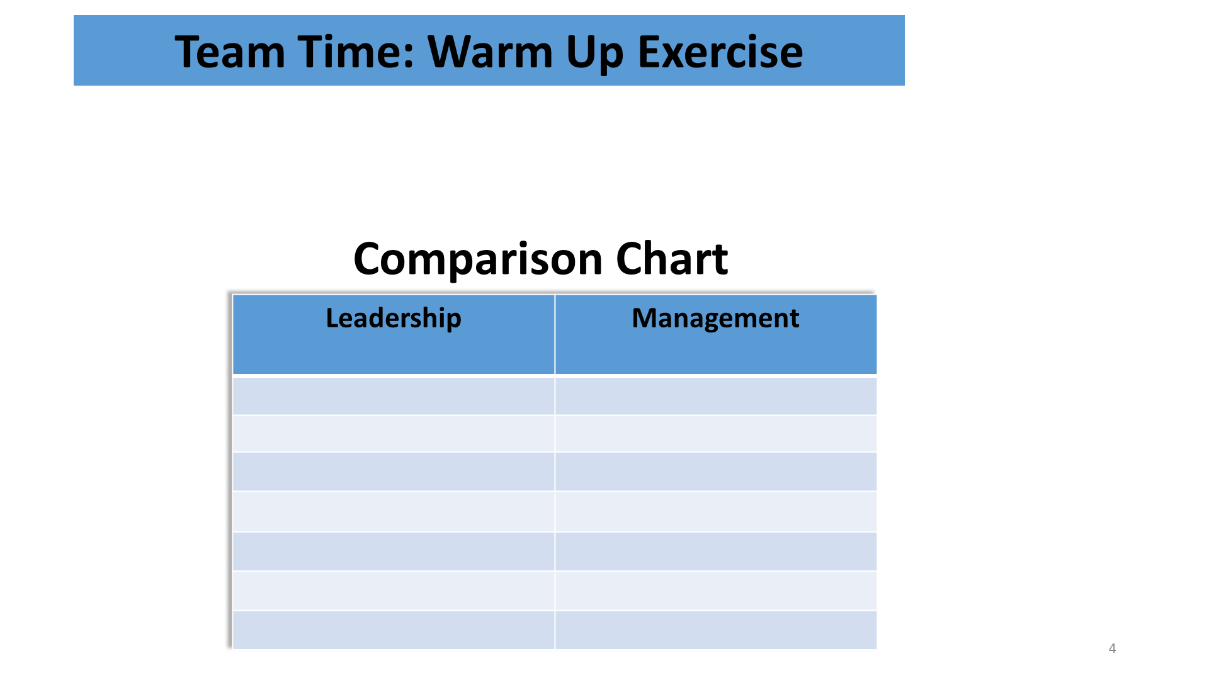
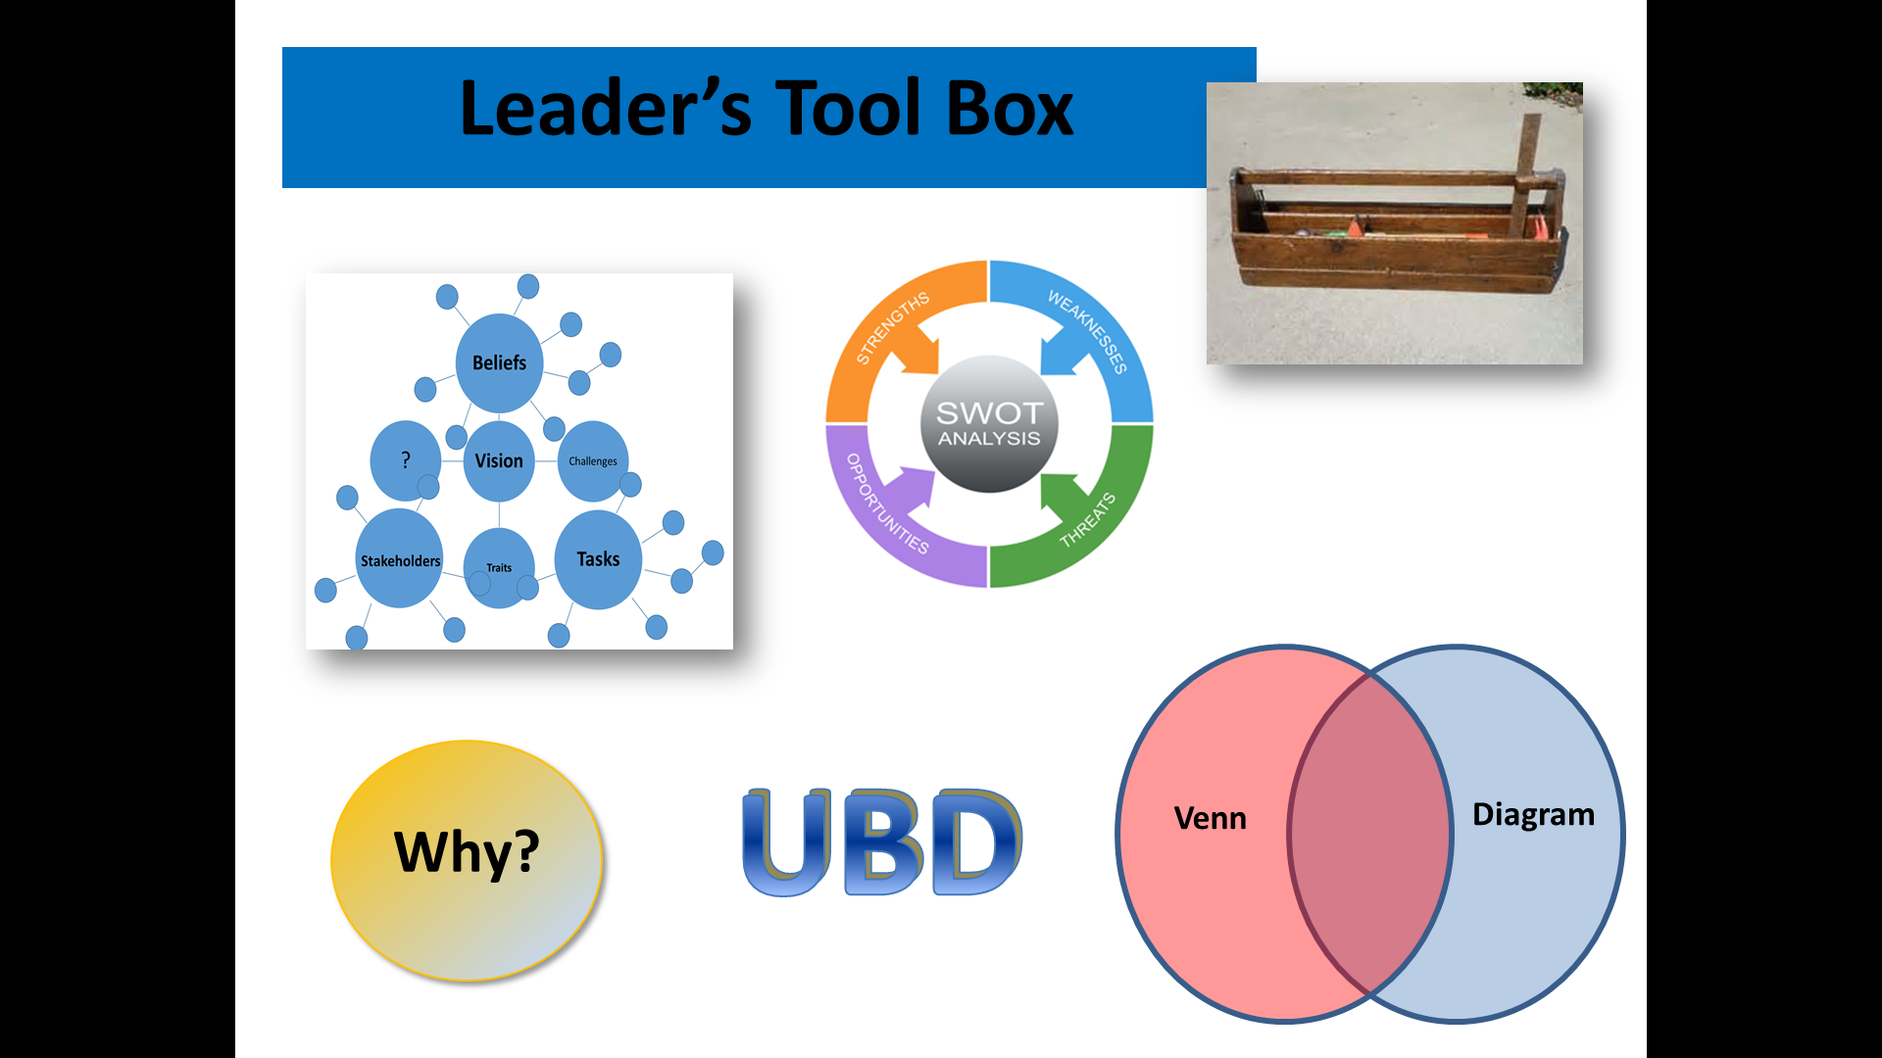
Leader’s Tool Box
Venn
Diagram
Why?
Action Plan

Slide 13

Encourage an organizational culture
in which “leadership manifests itself
at all levels of the organization.”
(Fullan, 2008)

Slide 15
Understanding By Design (UBD)
(Wiggins & McTighe, 1998)
Understanding By Design (UBD)
a theory that suggests that we can learn more deeply if we know the end goal of our learning experiences.

Slide 16
Understanding by Design
Goal
(Wiggins & McTighe, 1998)
Plan
Evidence of
Attainment
Process
“Backward Design”
Notes:
Identify Desired Results
What are worthy, appropriate results?
What are the key desired learnings?
What should students come away understanding, knowing and able to do?
What big ideas can frame these objectives?
What essential questions can help students explore?
Determine Acceptable Evidence
What is evidence of the desired results?
In particular, what is appropriate evidence of the desired understanding?
Plan Learning Experiences
What learning activities and teaching promote understanding, knowledge, skill, student interest and excellence?

Slide 17
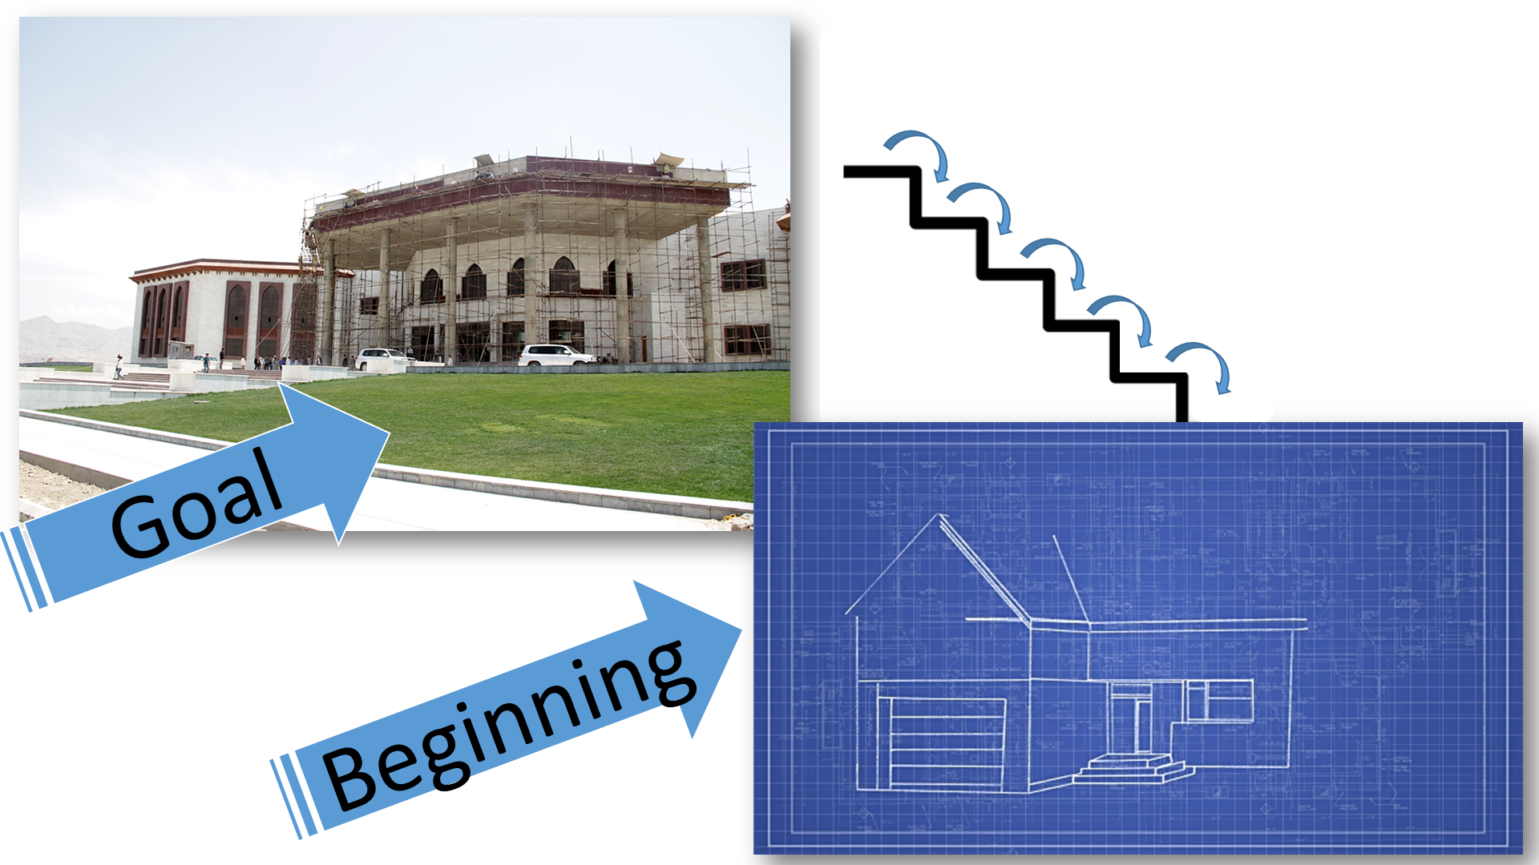
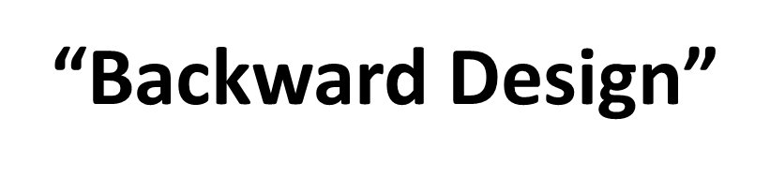

Slide 18
Understanding By Design (UBD)
(Wiggins & McTighe, 1998)
Understanding By Design (UBD)
in Organizational Leadership, followers are more willing and able to support, meet, and exceed the goals if they are valued as key players in the success and know what the ultimate goals are.

Slide 19

Understanding By Design (UBD)
(Wiggins & McTighe, 1998)
“My players cannot score if they do not know where the goal is.”
(McCarthy, often)

Slide 20

UBD + Action Plan
1. Consider your Team Vision.
Walk “Backwards” Down the
Steps from that Goal.
Work Together to Come to the Starting Point
to Reach that Goal.
(Wiggins & McTighe, 1998)

Slide 21
Action Plan
A Document that Lists a Sequence of Steps that Must Be Performed Well, For A Strategy To Succeed; that is to attain your Goal.
Three Major Elements
Specific Tasks: What Will be done and by Whom.
Deadline: When Will It Be Done.
Resource Allocation: What Specific Funds and Time Are Available for Specific Activities

Slide 22
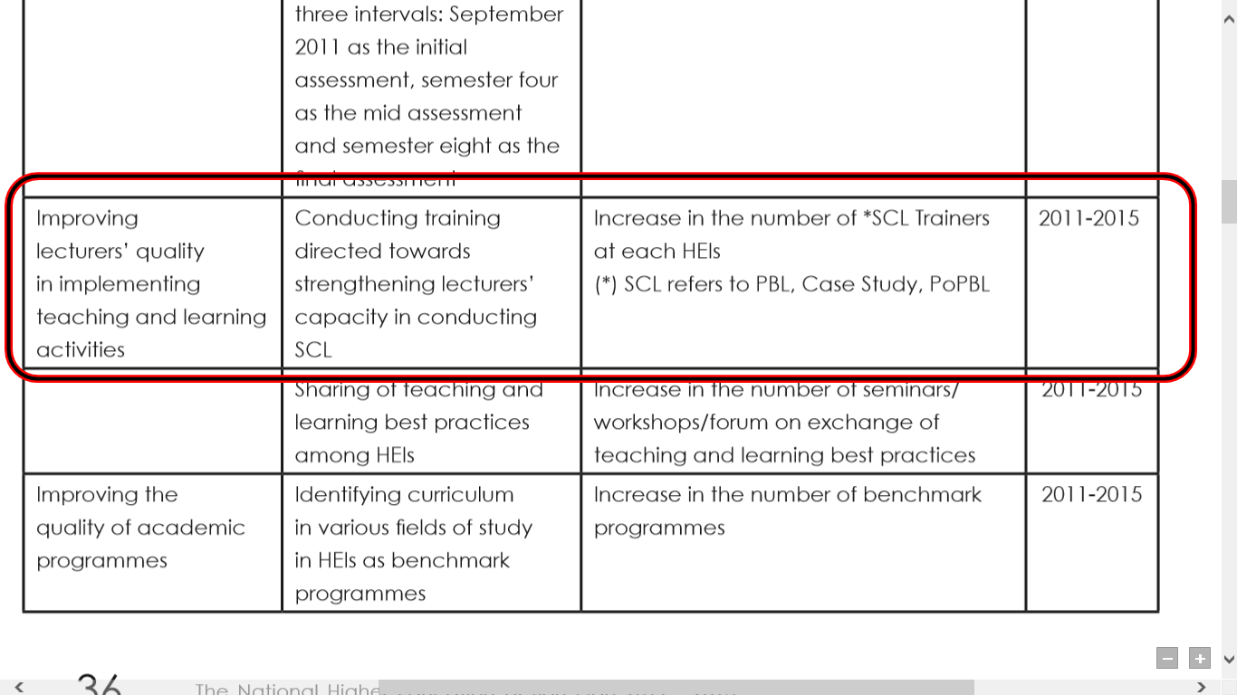
Specific Goal Specific Tasks Resource Allocation Deadline
EXAMPLE

Slide 23
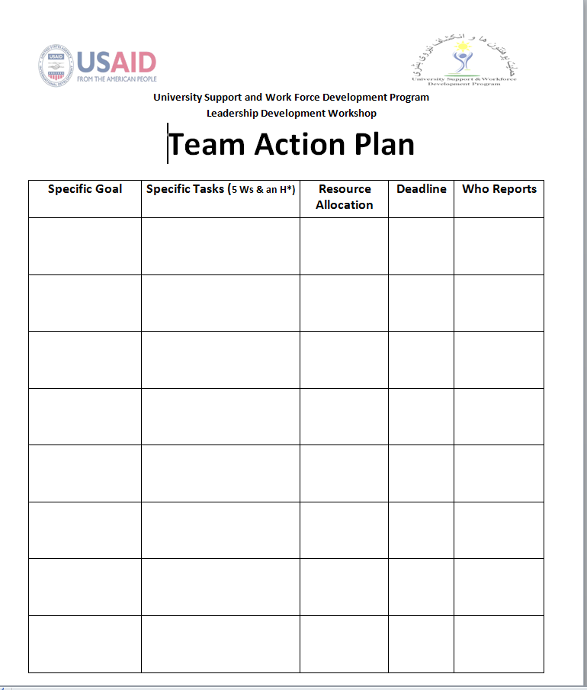
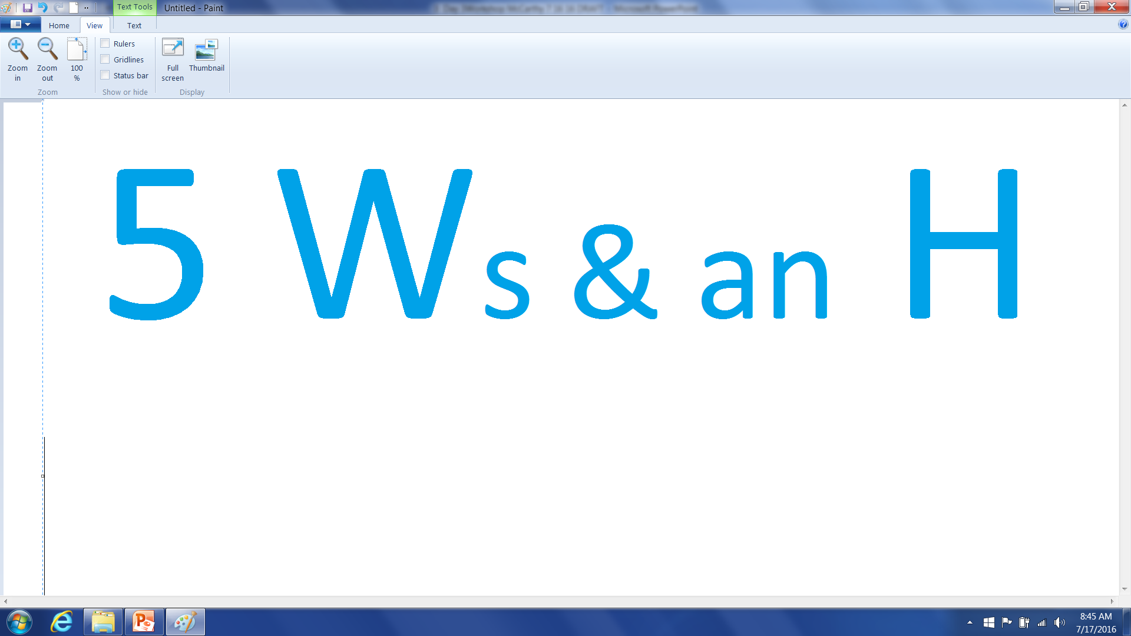
Action Plan

Slide 24
Specific Tasks 5 Ws & an H*
Who is Responsible?
What Specifically is to be Done?
Where will this be Done?
When do we need it by?
How will this be done?
Who Checks that it is Done?
(McCarthy, often)

Slide 25
Action Plan
Team Work Time

Slide 26
Action Plan
Report Out

Slide 27
Team Assignment
Finalize Your Vision Statements
In 5 years…

Slide 28
Sharing Your Vision Statements
Report Out

Slide 29

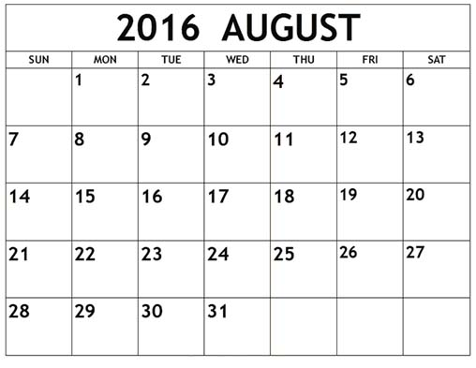
What are our Next Steps?
Skype Sessions
1 Month
2 Months
3 Months
4 Months
5 Months
6 Months

Slide 30

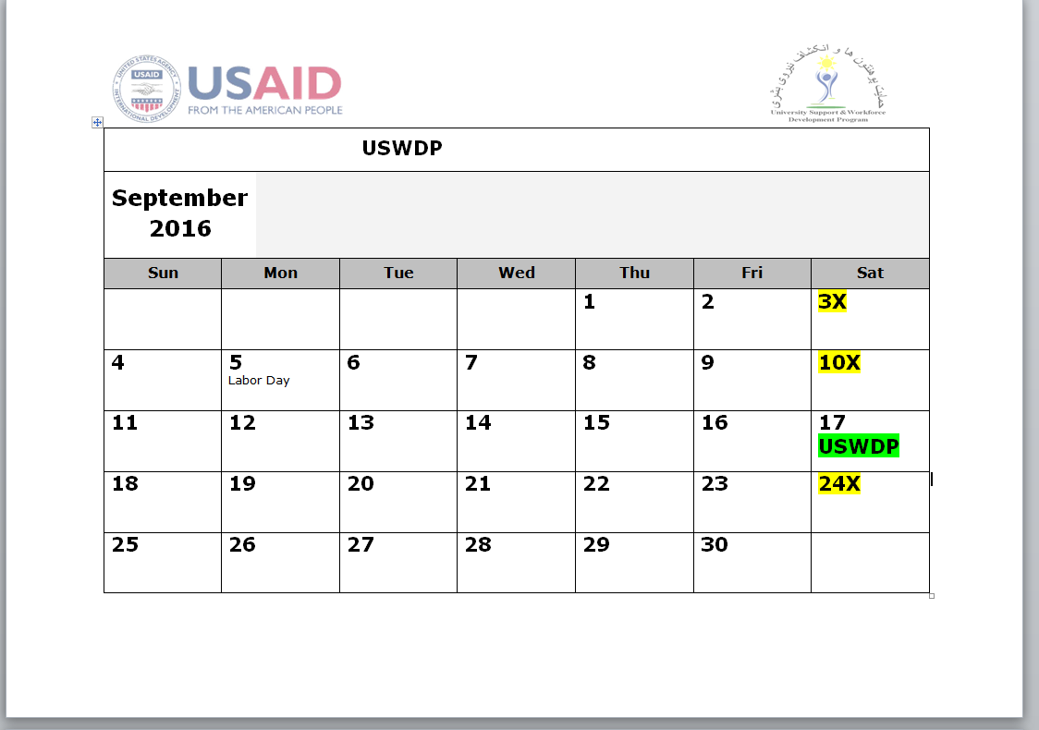
September 17, 2016

Slide 31
Reflection on This Week’s Experiences

Slide 32

Feedback?

Slide 33

Celebrate our Success!
Notes:
Certificates

